Slide 1
Handling HTML forms with PHP
PHP was designed as a web-scripting language
A dynamic website may have forms, sessions, and sometimes redirection
A session is a way to store information (in variables) to be used across multiple pages.
Session variables hold information about one single user, and are available to all pages in one application.
HTTP Basics
When a web browser requests a web page, it sends an HTTP request message to a web server. The request message always includes some header information, and it sometimes also includes a body.
GET /index.html HTTP/1.1

Slide 2
The two most common HTTP methods are GET and POST.
The GET method is designed for retrieving information, such as a document, an image, or the results of a database query, from the server.
The POST method is meant for posting information, such as a credit card number or information that is to be stored in a database, to the server

Slide 3
Variables
EGPCS (environment, GET, POST, cookies, and server)
$_COOKIE Contains any cookie values passed as part of the request, where the keys of the array are the names of the cookies $_GET Contains any parameters that are part of a GET request, where the keys of the array are the names of the form parameters $_POST Contains any parameters that are part of a POST request, where the keys of the array are the names of the form parameters $_FILES Contains information about any uploaded files $_SERVER Contains useful information about the web server $_ENV Contains the values of any environment variables, where the keys of the array are the names of the environment variables

Slide 4
Handling HTML forms
Both GET and POST create an array (e.g. array( key1 => value1, key2 => value2, key3 => value3, ...)).
keys ➔names of the form controls
values ➔ input data from the user.
GET and POST are treated as $_GET and $_POST.
$_GET is an array of variables passed to the current script via the URL parameters.
$_POST is an array of variables passed to the current script via the HTTP POST method.
$_REQUEST Contains the values of both the $_GET and $_POST arrays combined, along with the values of the $_COOKIE superglobal array

Slide 5
Get Method
Information sent from a form with the GET method is visible to everyone
all variable names and values are displayed in the URL.
GET also has limits on the amount of information to send. The limitation is about 2000 characters.
GET may be used for sending non-sensitive data.
GET should NEVER be used for sending passwords or other sensitive information

Slide 6
post
Information sent from a form with the POST method is invisible to others
all names/values are embedded within the body of the HTTP request
no limits on the amount of information to send.
Moreover POST supports advanced functionality such as support for multi-part binary input while uploading files to server.
However, because the variables are not displayed in the URL, it is not possible to bookmark the page.

Slide 7
<html>
<head>
<title>My First HTML web page</title>
<?php
echo $_GET["name"];
echo $_GET[“city"];
?>
</head>
<body>
<FORM name="form1" action="firstexample.php" method="GET"> Name : <input type="text" name="name"><br>
City : <input type="text" name="city"><br>
<input type="submit" name="Submit1" value="Login">
</FORM>
</body>
</html>

Slide 8
<?php
$name = $_POST["name"];
$email = $_POST["email"];
$message = $_POST["message"];
// Display the submitted data
echo "Name: " . $name . "<br>";
echo "Email: " . $email . "<br>";
echo "Message: " . $message . "<br>";
?>
<!DOCTYPE html>
<html>
<head>
<title>Example Form</title>
</head>
<body>
<h1>Example Form</h1>
<form action="welcome.php" method="post">
<label for="name">Name:</label>
<input type="text" id="name" name="name" required><br><br>
<label for="email">Email:</label>
<input type="email" id="email" name="email" required><br><br>
<label for="message">Message:</label>
<textarea id="message" name="message" rows="5" cols="30" required></textarea><br><br>
<input type="submit" value="Submit">
</form>
</body>
</html>

Slide 9
redirection
header("location:add.php");
The type of method that was used to request a PHP page is available through $_SERVER['REQUEST_METHOD']. For example: if ($_SERVER['REQUEST_METHOD'] == 'GET') { // handle a GET request } else { die("You may only GET this page."); }
header("Expires: Fri, 18 Jan 2006 05:30:00 GMT");

Slide 10
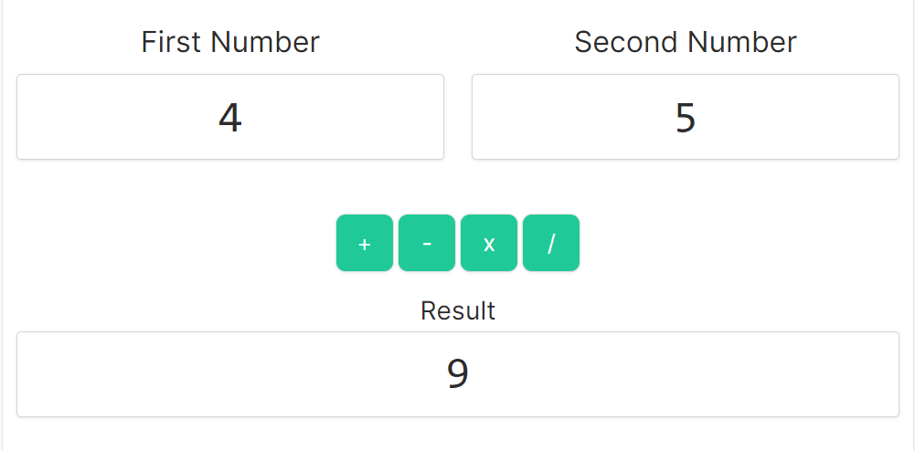
Question
Develop a webpage for Arithmetic calculator

Slide 11
<?php
if(isset($_GET['submit']))
{
}
?>

Slide 12
Contact Form: Create a contact form on a website that allows visitors to send messages or inquiries. PHP can be used to process the form and send emails.
Online Quiz or Survey: Develop an online quiz or survey application where users can answer questions and see their results. PHP can score quizzes and store survey responses.

Slide 13
Call JS
<html>
<head>
<script type="text/javascript">
function jsFunction(s){
alert(s);
}
</script>
</head>
<body>
<FORM method="post">
Name : <input type="text" name="na"><br>
<input type="submit" name="Submit1" value="Login">
</FORM>
<?php
$S=$_POST["na"];
echo "<script>jsFunction('$S');</script>";
?>
</body>
</html>

Slide 14
Sticky Forms
<html>
<head><title>Temperature Conversion</title></head>
<body>
<?php $fahrenheit = $_GET['fahrenheit']; ?>
<form action="<?php echo $_SERVER['PHP_SELF']; ?>" method="GET">
Fahrenheit temperature:
<input type="text" name="fahrenheit" value="<?php echo $fahrenheit; ?>" /><br />
<input type="submit" value="Convert to Celsius!" />
</form>
<?php if (!is_null($fahrenheit)) {
$celsius = ($fahrenheit - 32) * 5 / 9;
printf("%.2fF is %.2fC", $fahrenheit, $celsius);
} ?>
</body>
</html>
Many websites use a technique known as sticky forms, in which the results of a query are accompanied by a search form whose default values are those of the previous query

Slide 15
Multi value
<html>
<head><title>Personality</title></head>
<body>
<form action="<?php echo $_SERVER['PHP_SELF']; ?>" method="GET">
Select your personality attributes:<br />
<select name="attributes[]" multiple>
<option value="perky">Perky</option>
<option value="morose">Morose</option>
<option value="thinking">Thinking</option>
<option value="feeling">Feeling</option>
<option value="thrifty">Spend-thrift</option>
<option value="shopper">Shopper</option>
</select><br />
<input type="submit" name="s" value="Record my personality!" />
</form>
<?php if (array_key_exists('s', $_GET)) {
$description = join(' ', $_GET['attributes']);
echo "You have a {$description} personality.";
} ?>
</body>
</html>

